Slide 1
CPSC 223J Final Project
Connect Four

Slide 2
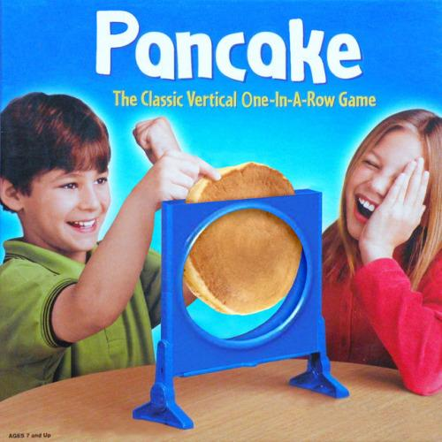

Slide 3
Key Aspects of Connect Four:
Turn based game
Connect four similar pieces in a row
Connection may be vertical
Connection may be horizontal
Connection may be diagonal
Stop opponent from connecting four similar pieces

Slide 4
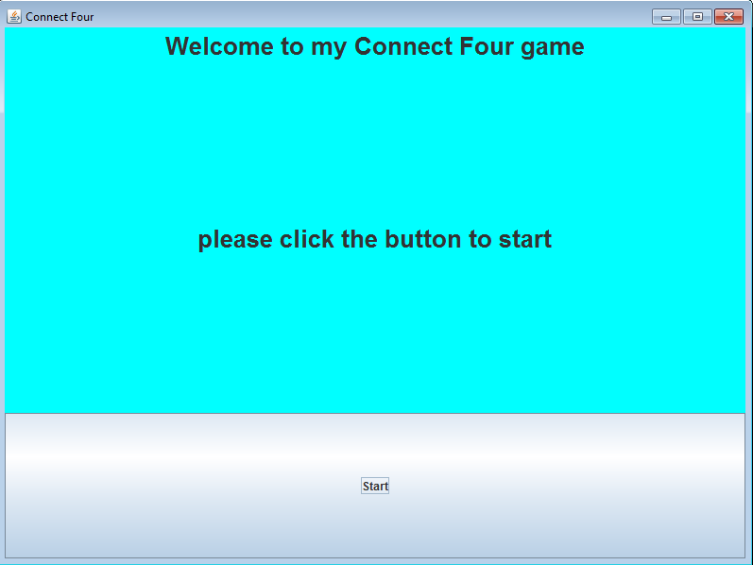
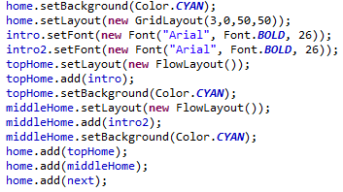
Formatting For Home Screen
Home panel uses grid layout to order the elements from top down
topHome and middleHome set to flow layout to be centered
next is added and fills up the space given by the grid layout

Slide 5
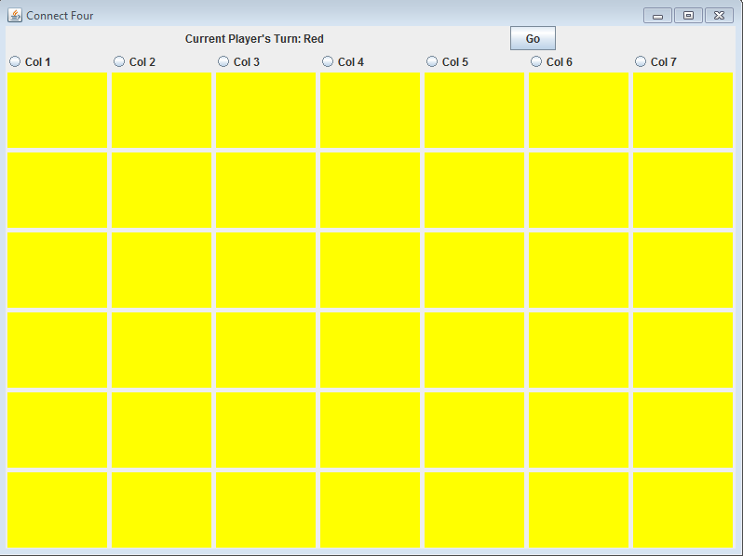
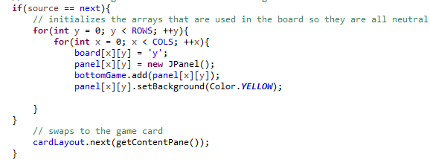
Initializing Game Screen
Array of characters created to keep track of three different states - ‘y’ meaning yellow or neutral - ‘r’ meaning red for red player move - and ‘b’ meaning blue for blue player move
Array of panels created and initialized to yellow for neutral state

Slide 6
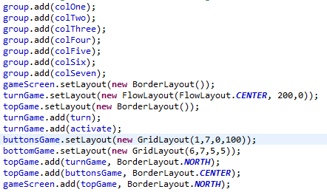
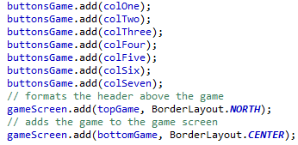
Initializing Game Screen
Radio buttons added into a button group so they will be checked as unique
Different panels were used to space out the elements and keep them in order above the play board
Go button reads in the player input and triggers a move to happen

Slide 7
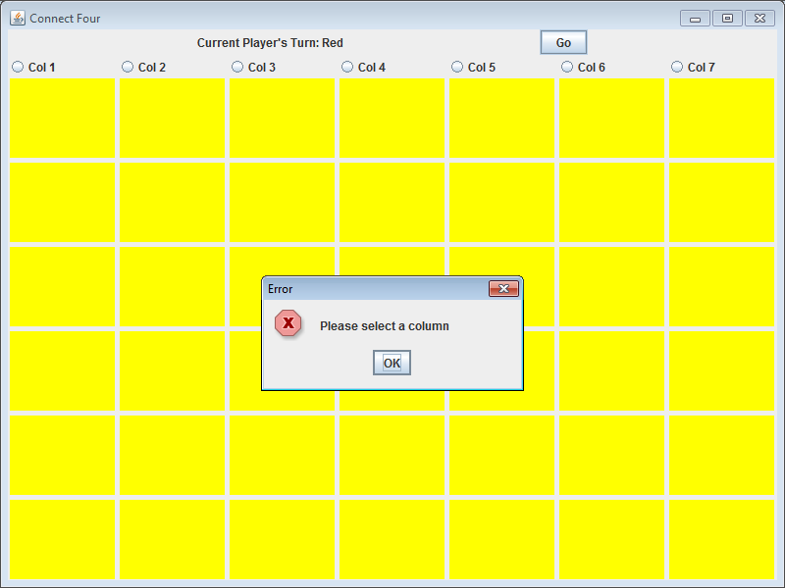
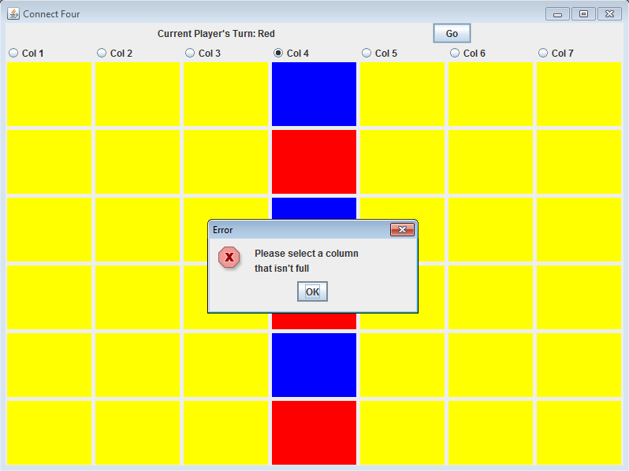
Error Checks
Various error checks happen when the program encounters a state in which an invalid action has occurred
A player is not allowed to end their turn without first entering a column they would like to drop their piece into
A player is unable to add elements to a column if the column has already filled all of the way up

Slide 8
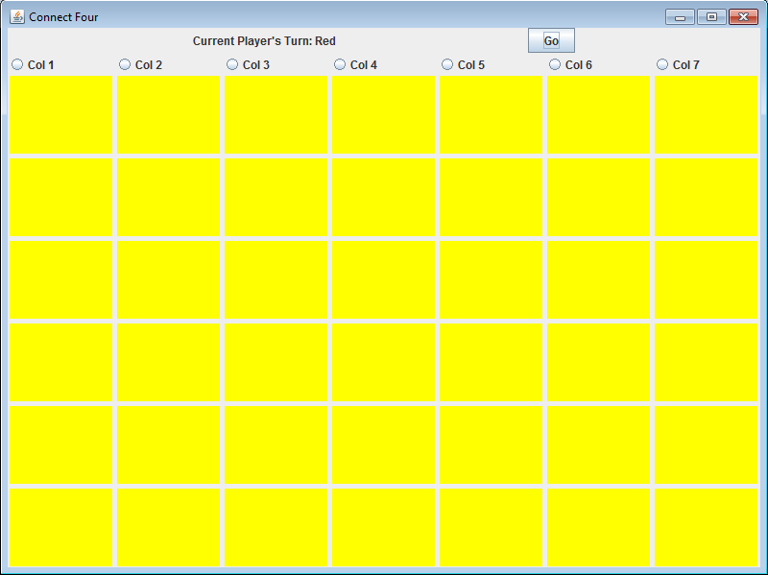
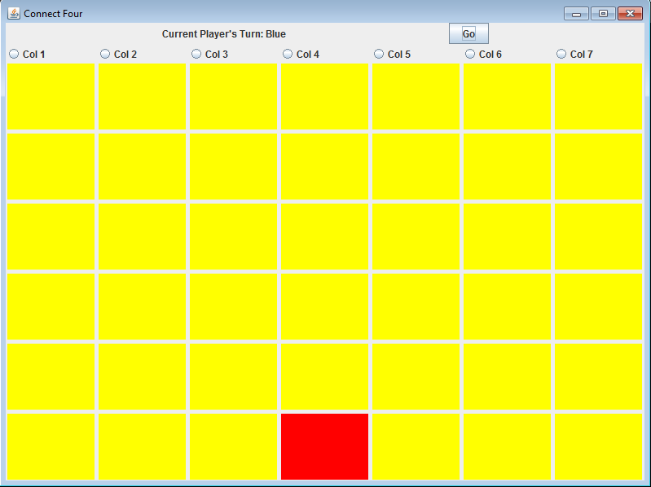
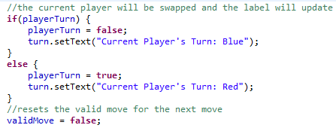
Player Turns
A player’s turn doesn’t complete until they have chosen their column and clicked go
Upon entering a valid input, the piece travels to the bottom of the column, the game checks for a win case, and then the turn is updated to the new player

Slide 9
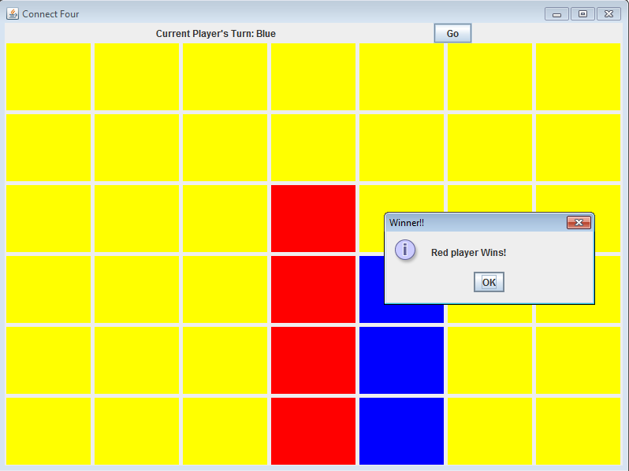
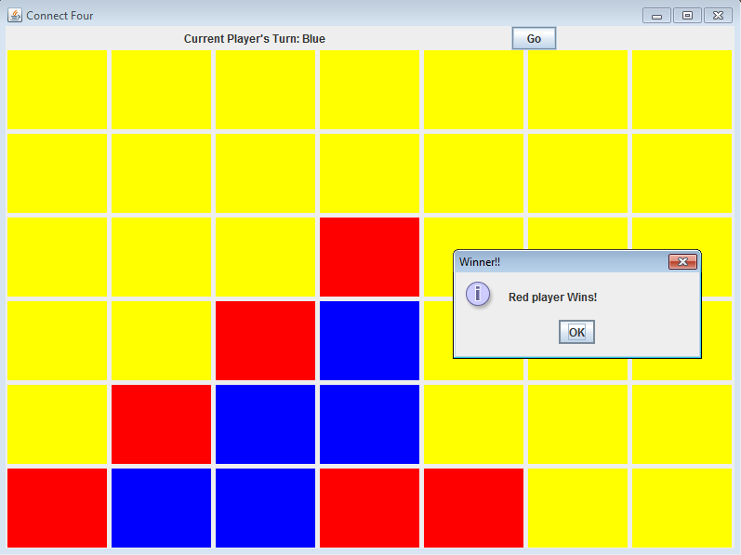
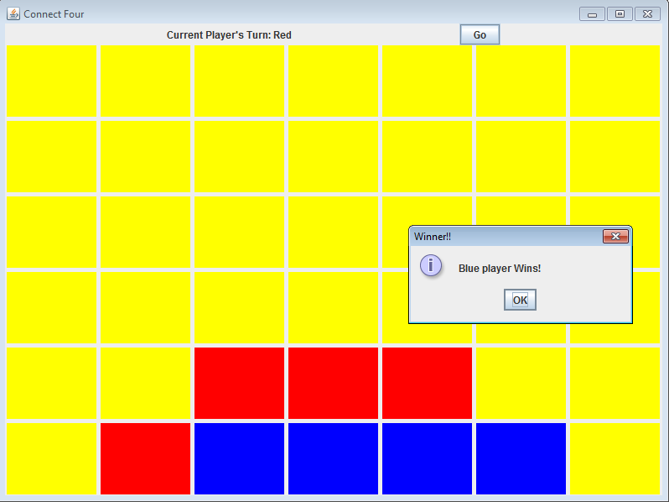
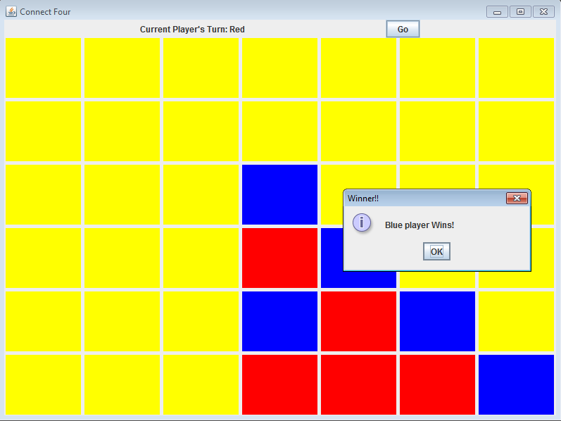
Possible Win Cases
A player may win the game by connecting four of the same color
Vertical, Horizontal, and both Diagonals work to check to see if a player has won

Slide 10
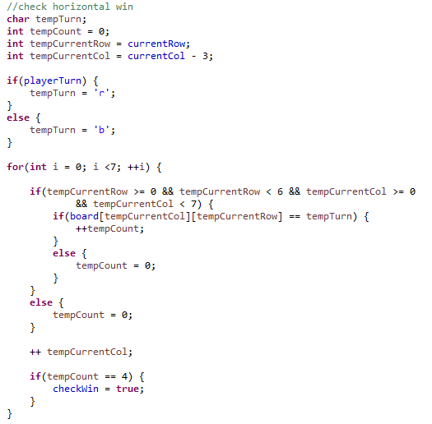
Possible Win Cases
Horizontal checks a sequence of 7 different positions
If a position contains a valid entry for the current player then a counter is incremented
Any time a position is invalid or doesn’t contain a good character then the counter is reset
If the counter reaches 4 then the boolean for a win state is set to true

Slide 11
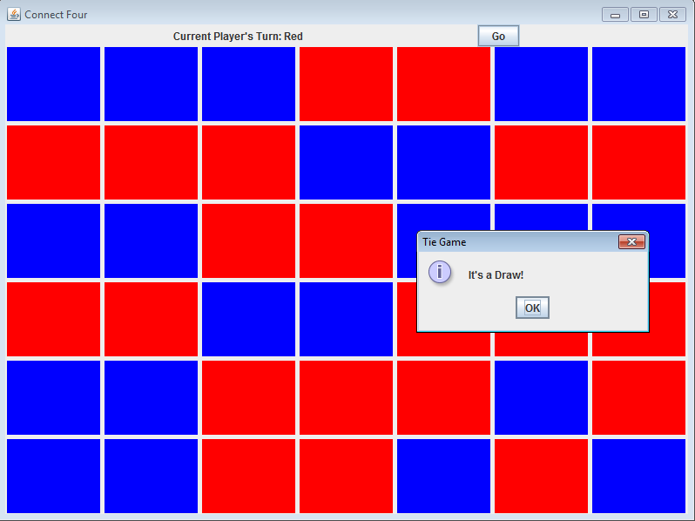

Possible Draw Case
If all possibilities have been occupied then the game will end in a draw sequence
The check for the draw case checks to see if all spaces are occupied while also checking to make sure the last case didn’t trigger the winning sequence

Slide 12


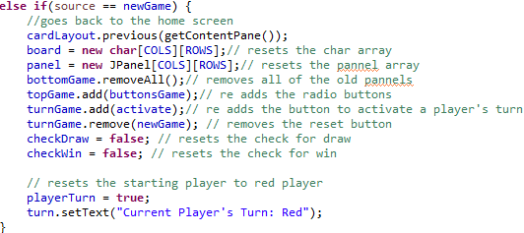
Reset Button
The Reset button replaces the activate turn button after an end game case has been reached
Many elements of the program are reset for the new run
The old panels are all removed, and the arrays are replaced by new arrays

